Slide 1
Memory Virtualization
Memory management in OS
Traditionally, OS fully controls all physical memory space and provide a continuous addressing space to each process.
In server virtualization, VMM should make all virtual machines share the physical memory space without knowing the fact.
Goals of memory virtualization :
Address Translation
Control table-walking hardware that accesses translation tables in main memory.
Memory Protection
Define access permission which uses the Access Control Hardware.
Access Attribute
Define attribute and type of memory region to direct how memory operation to be handled.

Slide 6
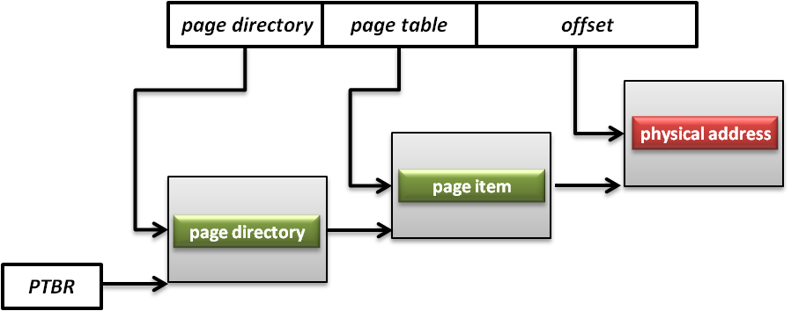
Memory Architecture
Memory Management Unit (MMU)
What is MMU ?
A computer hardware component responsible for handling accesses to memory requested by the CPU.
Its functions include translation of virtual addresses to physical addresses, memory protection, cache control, bus arbitration and etc.
What is PTBR ?
Page Table Base Register (PTBR) is a register point to the base of page table for MMU.

Slide 7
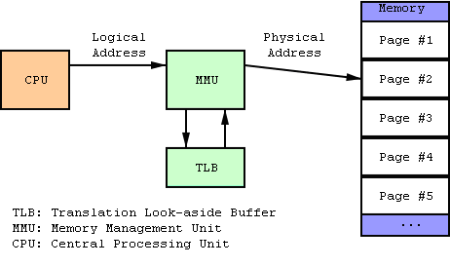
Memory Architecture
Translation Lookaside Buffer (TLB)
What is TLB ?
A CPU cache that memory management hardware uses to improve virtual address translation speed.

Slide 8
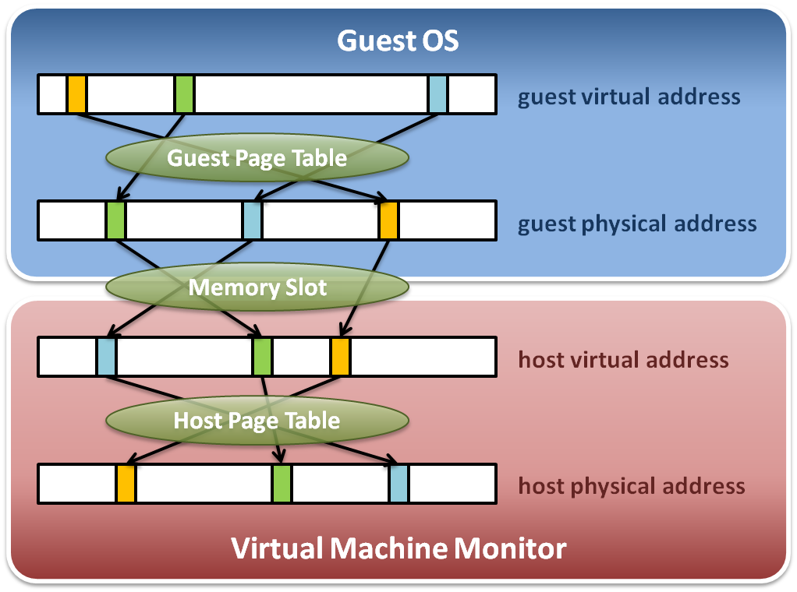
Memory Virtualization
Memory virtualization architecture

Slide 9
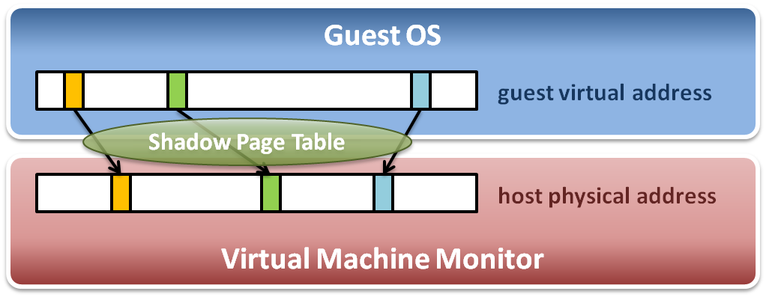
Memory Virtualization
The performance drop of memory access is usually unbearable. VMM needs further optimization.
VMM maintains shadow page tables :
Direct virtual-to-physical address mapping
Use hardware TLB for address translation

Slide 10
Shadow Page Table
Map guest virtual address to host physical address
Shadow page table
Guest OS will maintain its own virtual memory page table in the guest physical memory frames.
For each guest physical memory frame, VMM should map it to host physical memory frame.
Shadow page table maintains the mapping from guest virtual address to host physical address.
Page table protection
VMM will apply write protection to all the physical frames of guest page tables, which lead the guest page table write exception and trap to VMM.

Slide 11
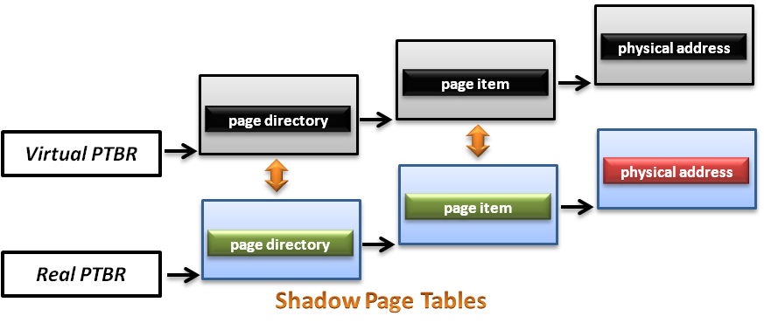
Shadow Page Table
How does this technique work ?
VMM should make MMU virtualized
VMM manages the real PTBR and a virtual PTBR for each VM
When guest OS is activated, the real PTBR points to a shadow page table
When guest OS attempts to modify the PTBR, it will be intercepted by VMM for further emulation

Slide 12
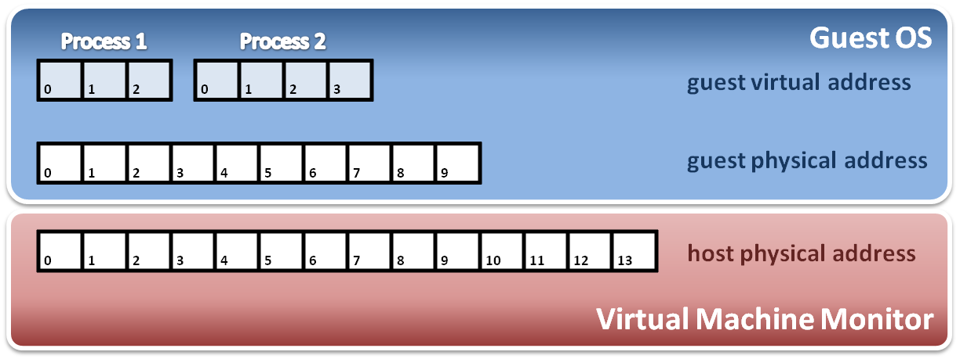
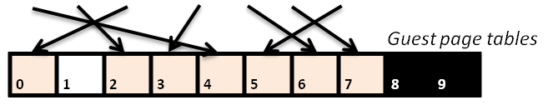
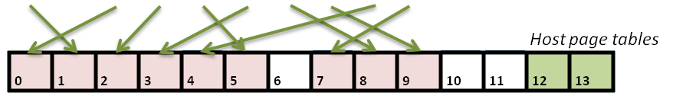
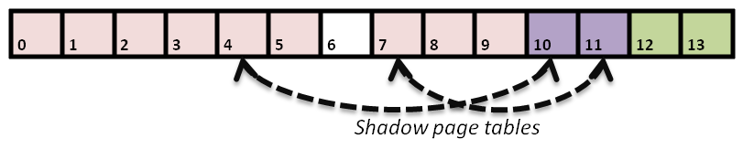
Shadow Page Table
Construct shadow page table
Guest OS will maintain its own page table for each process.
VMM maps each guest physical page to host physical page.
Create shadow page tables for each guest page table.
VMM should protect host frame which contains guest page table.
Write protection

Slide 13
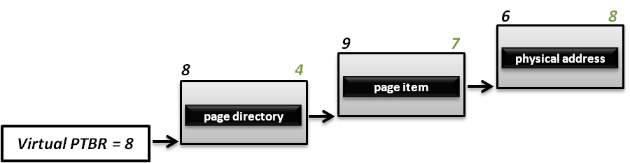
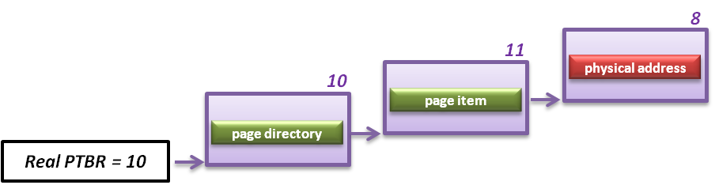
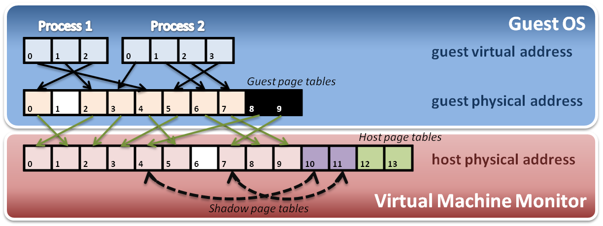
Shadow Page Table
Implement with PTBR :
For example, process 2 in guest OS want to access its memory whose page number is 1.

Slide 14
Shadow Page Table
Shadow page table operations :
Context switch
New process
Access
Process
Page Table
Process
Page Table
Process
Page Table
Virtual PTPR
Guest OS
Real PTPR
VMM
Page fault !
Shadow
Page Table
Shadow
Page Table
Shadow
Page Table
Load !
Corresponding mapping table
Switch the pointer to new location
Create new shadow page table mapping to new process

Slide 15
Other Issues
Page fault and page protection issue
When a physical page fault occurs, VMM need to decide whether this exception should be injected to guest OS or not.
If the page entry in the page table of guest OS is still valid, VMM should prepare the corresponding page and not inject any exception to guest OS.
If the page entry in the page table of guest Os is invalid either, then VMM should directly inject the virtual page fault to guest OS.
When guest OS want to modify its page tables, VMM need to intercept this operation.
When guest OS reload PTBR, CPU will trap to VMM due to the Ring Compression nature.
VMM will walk the page table of guest OS and modify the related shadow page table to make MMU get host physical address.

Slide 16
Memory Virtualization
Shadow page table
Hardware assistance

Slide 17
Hardware Solution
Difficulties of shadow page table technique :
Shadow page table implementation is extremely complex.
Page fault mechanism and synchronization issues are critical.
Host memory space overhead is considerable.
But why we need this technique to virtualize MMU ?
MMU do not first implemented for virtualization.
MMU is knowing nothing about two level page address translation.
Now, let us consider hardware solution.

Slide 18
Extended Page Table
Concept of Extended Page Table (EPT) :
Instead of walking along with only one page table hierarchy, EPT technique implement one more page table hierarchy.
One page table is maintained by guest OS, which is used to generate guest physical address.
The other page table is maintained by VMM, which is used to map guest physical address to host physical address.
For each memory access operation, EPT MMU will directly get guest physical address from guest page table, and then get host physical address by the VMM mapping table automatically.

Slide 19
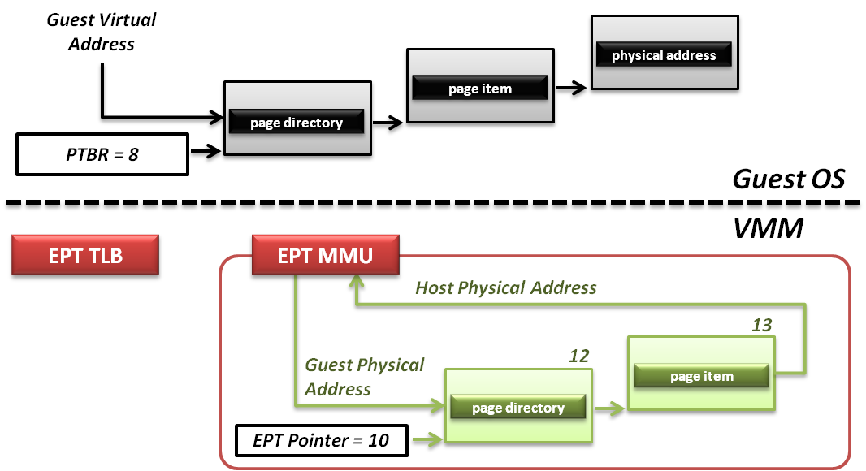
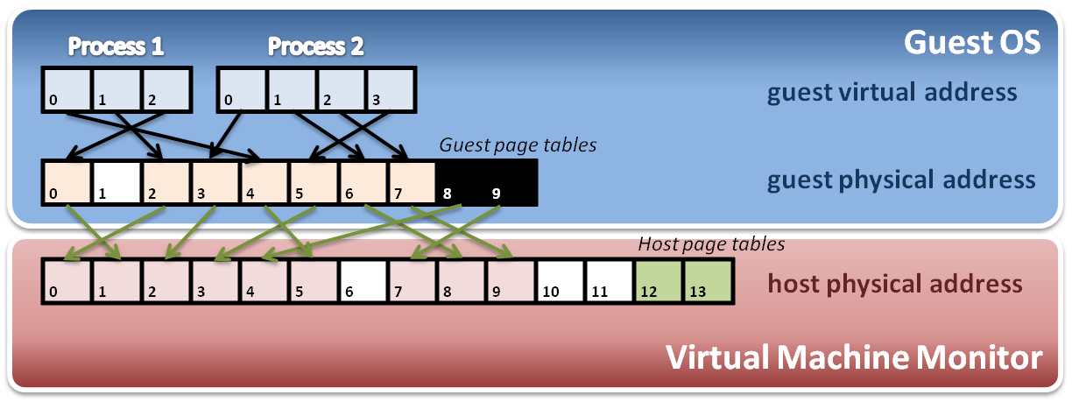
Extended Page Table
Memory operation :
6
8
9
7
8
4
Data

Slide 20
Memory Virtualization Summary
Software implementation
Memory architecture
MMU (memory management unit)
TLB (translation lookaside buffer)
Shadow page table
MMU virtualization by virtual PTBR
Shadow page table construction
Page fault and page table protection
Hardware assistance
Extended page table
Hardware walk guest and host page table simultaneously

Slide 21
IO Virtualization
Overview
Device Model
Hardware Assistance

Slide 22
IO Virtualization
Goal :
Share or create IO devices for virtual machines.
Two types of IO subsystem architecture :
Port Mapped IO
Port-mapped IO uses a special class of CPU instructions specifically for performing IO.
Memory Mapped IO (MMIO)
Memory Mapped IO uses the same address bus to address both memory and IO devices, and the CPU instructions used to access the memory are also used for accessing devices.
Traditional IO techniques :
Direct memory Access (DMA)
PCI / PCI Express

Slide 23
Port Mapped IO
IO devices are mapped into a separate address space
IO devices have a separate address space from general memory, either accomplished by an extra “IO" pin on the CPU's physical interface, or an entire bus dedicated to IO.
Generally found on Intel microprocessors, specifically the IN and OUT instructions which can read and write one to four bytes (outb, outw, outl) to an IO device.
Pros & Cons
Pros
Less logic is needed to decode a discrete address.
Benefits for CPUs with limited addressing capability.
Cons
More instructions are required to accomplish the same task.
IO addressing space size is not flexible.

Slide 24
Memory Mapped IO
IO devices are mapped into the system memory map along with RAM and ROM.
To access a hardware device, simply read or write to those 'special' addresses using the normal memory access instructions.
Pros & Cons
Pros
Instructions which can access memory can be used to operate an IO device.
Operate on the data with fewer instructions.
Cons
Physical memory addressing space must be shared with IO devices.
The entire address bus must be fully decoded for every device.

Slide 25
Direct Memory Access
What is DMA ?
Allow certain hardware subsystems within the computer to access system memory for reading and/or writing independently of the central processing unit.
Two types of DMA :
Synchronous DMA
The DMA operation is caused by software.
For example, sound card driver may trigger DMA operation to play music.
Asynchronous DMA
The DMA operation is caused by devices (hardware).
For example, network card use DMA operation to load data into memory and interrupt CPU for further manipulation.

Slide 26
PCI & PCI Express
What is PCI ?
PCI (Peripheral Component Interconnect) is a computer bus for attaching hardware devices.
Typical PCI cards used include :
Network cards, sound cards, modems
Extra ports such as USB or serial, TV tuner cards and disk controllers.
What is PCI Express ?
PCIe is a computer expansion card standard designed to replace the older PCI, PCI-X, and AGP standards.
Its topology is based on point-to-point serial links, rather than a shared parallel bus architecture.

Slide 27
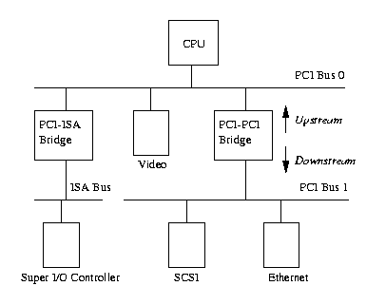
PCI & PCI Express
PCI based system build in a tree topology
PCI bus
Parallel connect devices and bridges
PCI-PCI Bridge
Connect two PCI buses
Become the root of lower bus
PCI-ISA Bridge
Connect to conventional ISA device

Slide 28
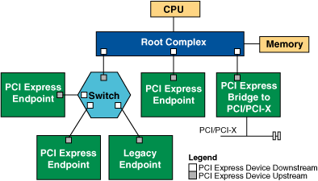
PCI & PCI Express
PCIe based system build in a point to point architecture
Root Complex
Similar to a host bridge in a PCI system, the root complex generates transaction requests on behalf of the processor, which is interconnected through a local bus.
Switch
Connect endpoint devices or other switches
Endpoint Device
Physical PCIe devices
Legacy PCI devices
PCI Express Bridge
Connect to other legacy subsystems

Slide 29
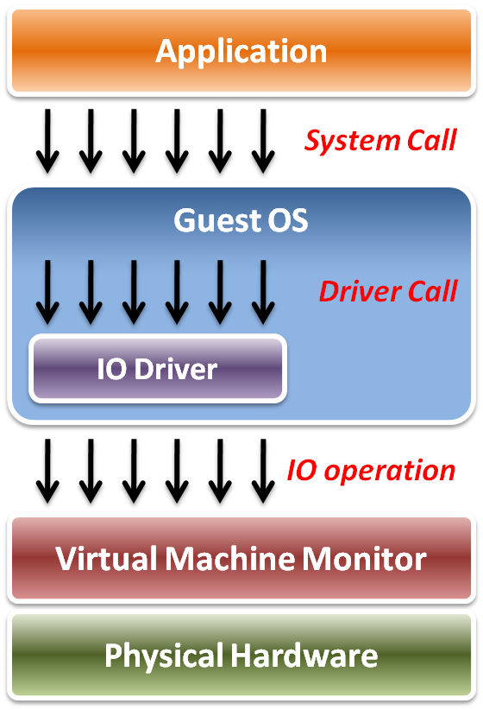
IO Virtualization
Implementation Layers :
System call
The interface between applications and guest OS.
Driver call
The interface between guest OS and IO device drivers.
IO operation
The interface between IO device driver of guest OS and virtualized hardware ( in VMM ).

Slide 30
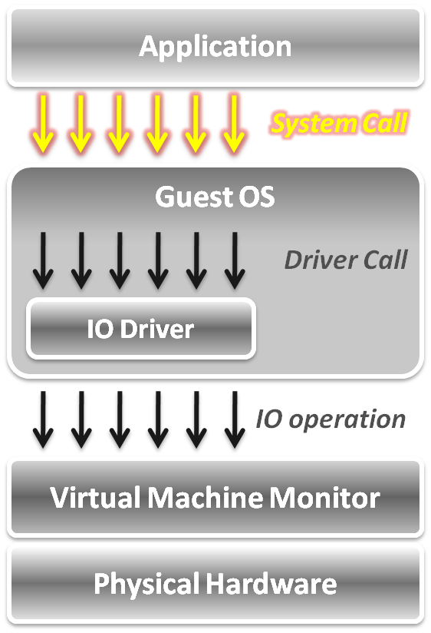
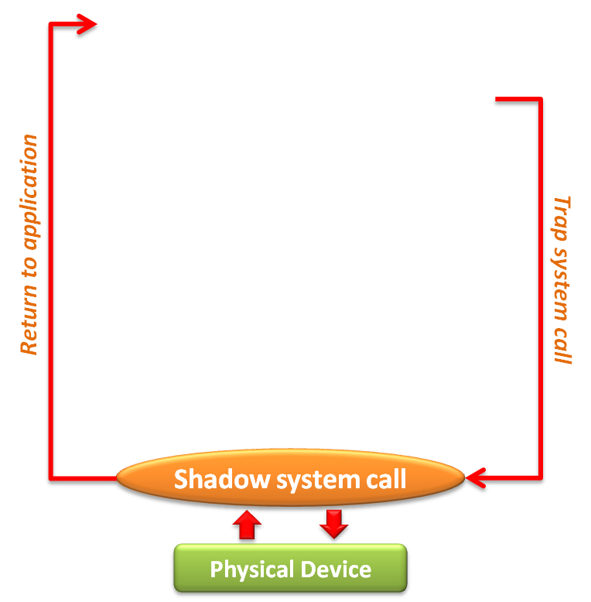
IO Virtualization
In system call level :
When an application invokes a system call, the system call will be trapped to VMM first.
VMM intercepts system calls, and maintains shadowed IO system call routines to simulate functionalities.
After simulation, the control goes back to the application in gust OS.

Slide 31
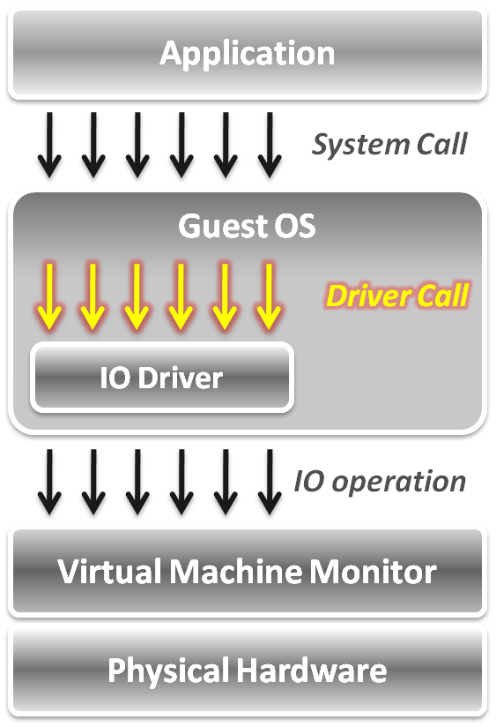
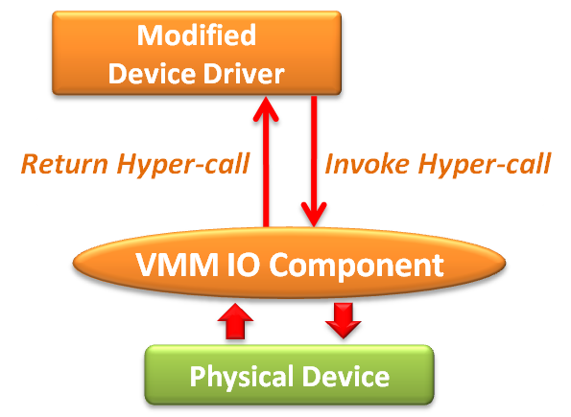
IO Virtualization
In device driver call level :
Adopt the para-virtualization technique, which means the IO device driver in guest OS should be modified.
The IO operation is invoked by means of hyper-call between the modified device driver and VMM IO component.

Slide 32
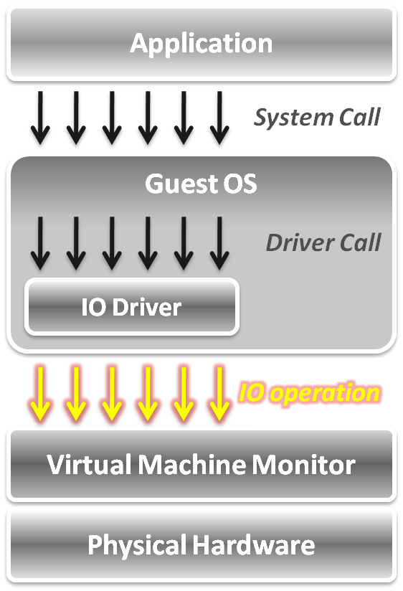
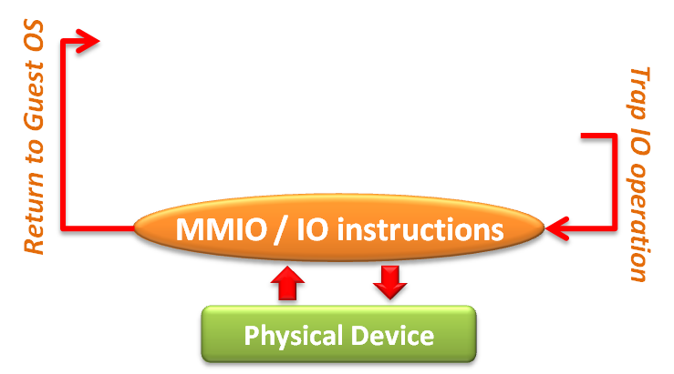
IO Virtualization
In IO operation level, two approaches :
Memory mapped IO
Loads/stores to specific region of real memory are interpreted as command to devices.
The memory mapped IO region is protected.
Port mapped IO
Special input/output instructions with special addresses.
The IO instructions are privileged .
Due to the privileged nature, these IO operations will be trapped to the VMM.

Slide 33
IO Virtualization
Overview
Device Model
Hardware Assistance

Slide 34
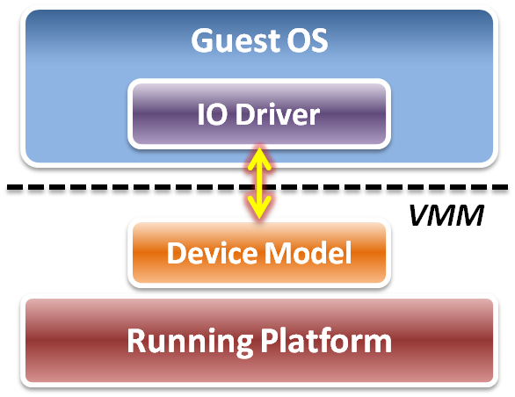
Device Model
Focus on IO operation level implementation.
This is an approach of full virtualization.
Logic relation between guest OS and VMM :
VMM intercepts IO operations from guest OS.
Pass these operations to device model on a running platform.
Device model needs to emulate the IO operation interfaces.
Port mapped IO
Memory mapped IO
DMA
... etc.

Slide 35
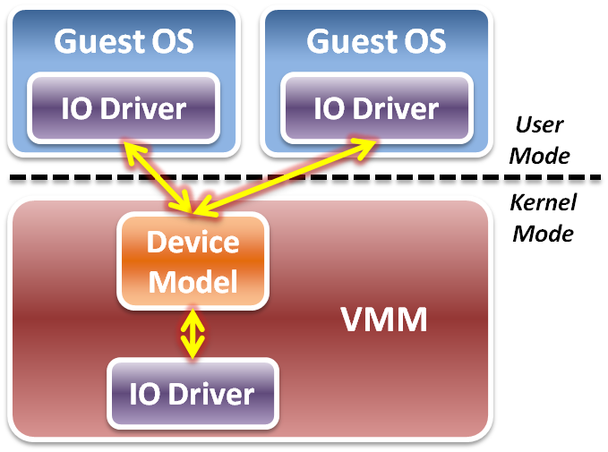
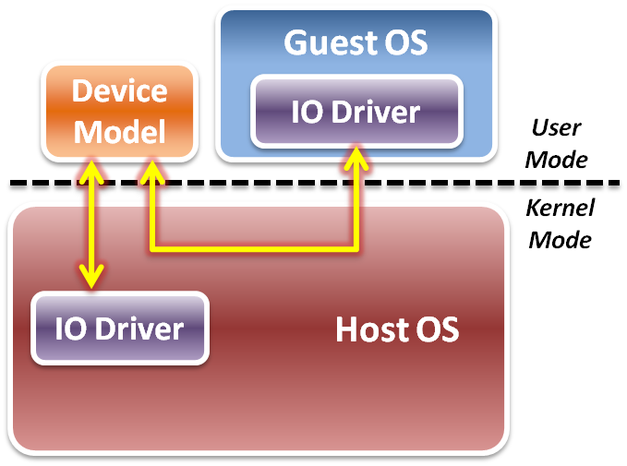
Device Model
Two different implementations of device model :
Device model is implemented as part of VMM.
Device model is running in user space as a stand alone service.
Type 1 Virtualization
Type 2 Virtualization

Slide 36
Device Model
IO virtualization flow
Initialization – device discovery
VMM will make guest OS discover the virtualized IO devices.
Then guest OS will load the corresponding device driver.
Operation – access interception
When guest OS executes IO operations, VMM will intercept those accesses.
After virtual device operations, VMM returns the control to guest OS.
Virtualization – device virtualization
Device model should emulate the real electronic logic to satisfy all device interface definition and its effects.
VMM may share physical devices to all virtual machines.

Slide 37
Device Discovery
Virtualize physical bus devices
Non-enumerable physical device
These devices have their own hard-coded numbers.
VMM should setup some status information on the virtual device ports.
For example, PS/2 keyboard and mouse.
Enumerable physical device
These devices defined a complete device discover method.
VMM have to emulate not only the device itself, but the bus behavior.
For example, PCI or PCI express devices.
Virtualize non-exist devices
VMM must define and emulate all functions of these devices
VMM may define them as either non-enumerable or enumerable devices.
Guest OS needs to load some new drivers of these virtual devices.

Slide 38
Access Interception
After virtual device discovered by guest OS, VMM has to intercept and control all the IO operations from guest OS.
Port mapped IO operation
Direct device assignment
VMM should turn ON the physical IO bitmap.
All the IO instructions (IN/OUT) from guest OS will be directly performed onto hardware without VMM intervention.
Indirect device assignment
VMM should turn OFF the physical IO bitmap.
All the IO instructions from guest OS will be intercepted by VMM and forward to physical hardware.

Slide 39
Access Interception
Memory mapped IO operation
Direct device assignment
VMM should use the shadow page table to map IO device addressing space of guest OS to the space of host.
Then all the IO operations from guest OS will not be intercepted.
Indirect device assignment
VMM should make the all entries of the IO device addressing space in the shadow page table to be invalid.
When guest OS access those addressing space, it will introduce the page fault which trap CPU to VMM for device emulation.
DMA mechanism
Address remapping
Because the device driver in the guest OS does not know the host physical address, VMM needs to remap the DMA target automatically when intercepting guest OS.

Slide 40
Device Virtualization
IO device types :
Dedicated device
Ex : displayer, mouse, keyboard …etc.
Partitioned device
Ex : disk, tape …etc
Shared device
Ex : network card, graphic card …etc.
Nonexistent physical device
Ex : virtual device …etc.

Slide 41
Device Virtualization
Dedicated device
Do not necessarily have to be virtualized.
In theory, requests of such device could bypass the VMM.
However, they are handled by the VMM first since OS is running in user mode.
Partitioned device
Be partitioned into several smaller virtual devices as dedicated to VM.
VMM translates address spaces to those of the physical devices.

Slide 42
Device Virtualization
Shared device
Should be shared among VMs.
Each VM has its own virtual device state.
VMM translates requests from a VM to physical device .
Nonexistent physical device
Virtual device “attached” to a VM for which there is no corresponding physical device.
VMM intercepts requests from a VM, buffers it and interrupts other VMs.

Slide 43
Performance Issues
When considering performance, two major problems :
How to make guest OS directly access IO addresses ?
Other than software approaches discussed above, we can make use of the hardware assistance (Intel EPT technique in memory virtualization) to map IO addresses from host to guest directly without software overhead.
How to make DMA directly access memory space in guest OS ?
For the synchronous DMA operation, guest OS will be able to assign the correct host physical memory address by EPT technique.
For the asynchronous DMA operation, hardware must access memory from host OS which will introduce the VMM intervention.

Slide 44
IO Virtualization
Overview
Device Model
Hardware Assistance

Slide 45
Hardware Solution
Difficulty :
Software cannot make data access directly from devices.
Tow hardware solutions :
Implement DMA remapping in hardware
Remap DMA operations automatically by hardware.
For example, Intel VT-d .
Specify IO virtualization standards of PCI Express devices
Implement virtualizable device with PCI Express interface.
For example, SR-IOV or MR-IOV.

Slide 46
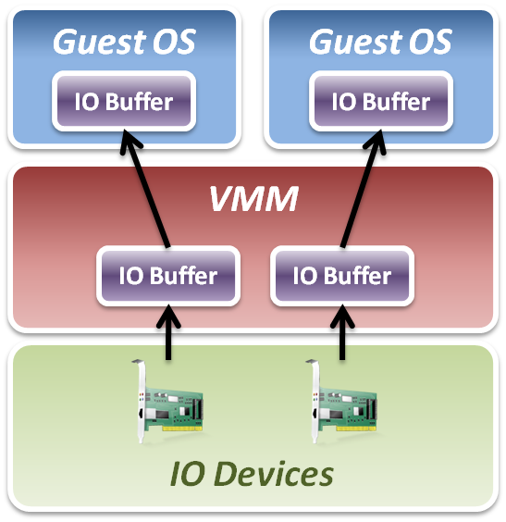
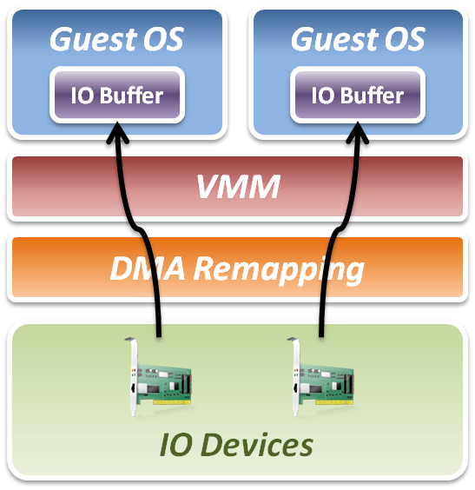
Intel VT-d
Add DMA remapping hardware component.
Software Approach
Hardware Approach

Slide 47
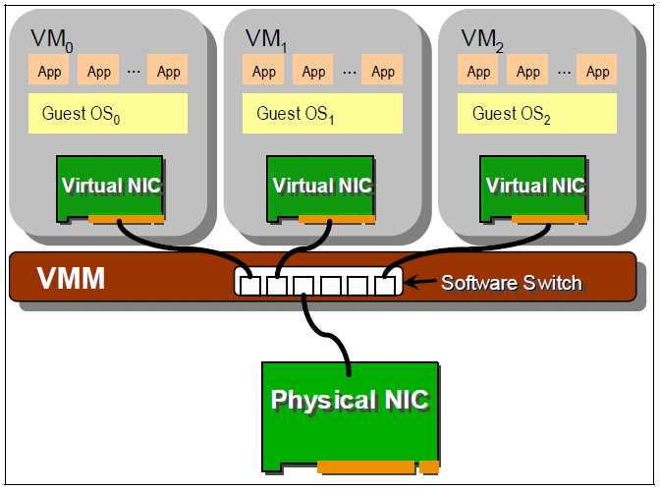
IO Virtualization Progress
Software based sharing
Implement virtualization by VMM software stack.
Advantage
Full virtualization without special hardware support.
Disadvantage
Significant CPU overhead may be required by the VMM.

Slide 48
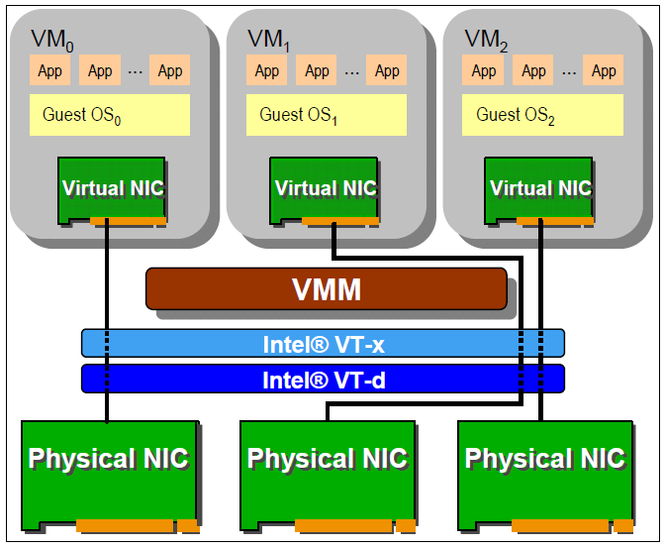
IO Virtualization Progress
Hardware direct assignment
Implement virtualization with Intel VT-x and VT-d supports.
Advantage
Data access bypass VMM.
Improve IO performance.
Disadvantage
Dedicate physical device assignment limit the system scalability.

Slide 49
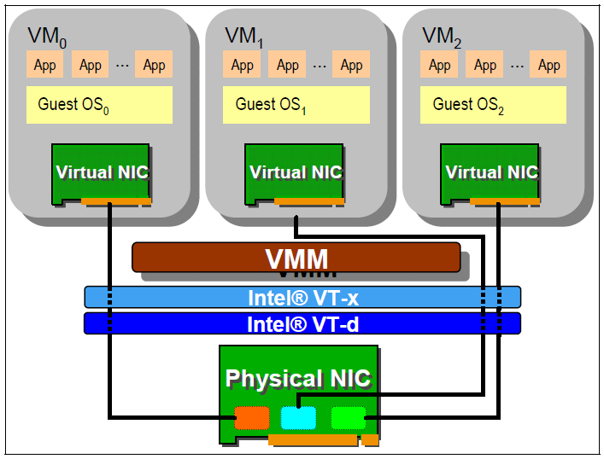
IO Virtualization Progress
New industrial standard
Instead of implementing virtualization in CPU or memory only, industry com up with new IO virtualization standard in PCI Express devices.
Advantages
Fully collaboration with physical hardware devices.
Improve system scalability.
Improve system agility.
Disadvantages
IO devices must implement with new specification.

Slide 50
Single Root – IO Virtualization
What is SR-IOV ?
The PCI-SIG Single Root I/O Virtualization and Sharing (SR-IOV) specification defines a standardized mechanism to create natively shared devices.
Basic components :
Physical Functions (PFs):
These are full PCIe functions that include the SR-IOV Extended Capability.
The capability is used to configure and manage the SR-IOV functionality.
Virtual Functions (VFs):
These are “lightweight” PCIe functions that contain the resources necessary for data movement but have a carefully minimized set of configuration resources.

Slide 51
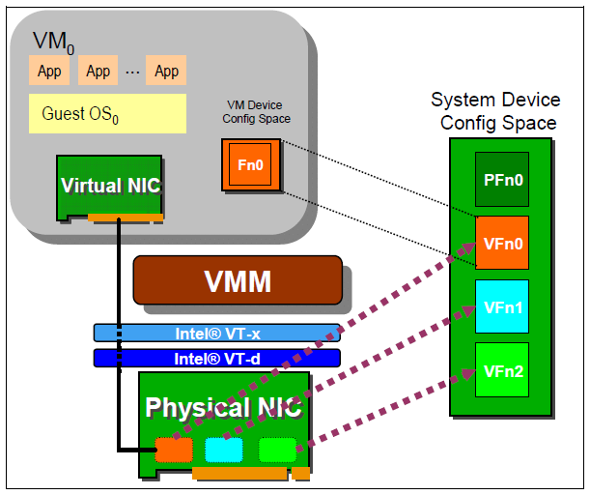
Single Root – IO Virtualization
SR-IOV works with VMM :
VMM
An SR-IOV-capable device can be configured to appear in the PCI configuration space as multiple functions.
VM
The VMM assigns one or more VFs to a VM by mapping the actual configuration space the VFs to the configuration space presented to the virtual machine by the VMM.

Slide 52
IO Virtualization Summary
IO subsystem architecture
Port Mapped IO vs. Memory Mapped IO
Direct Memory Access (DMA)
PCI / PCI Express
IO virtualization
Three implementation layers
IO virtualization paradigm with device model
Hardware assistance
DMA remapping hardware
Single Root – IO Virtualization specification

